Slide 1
Chapter 3: Raster Data Model

Slide 2
Overview
The raster data model has not changed in terms of its concept for the past four decades.
Research on the raster data model has instead concentrated on new raster data, data structure, data compression, and integration of raster and vector data.
A wide variety of data used in geographic information system (GIS) are encoded in raster format.
They include digital elevation data, satellite images, digital orthophotos, scanned maps, and graphic files.
Therefore, issues of data storage and retrieval are important to GIS users
In many ways, raster and vector data complement each other.
Viable for continuous data

Slide 3
Overview
The raster data model has not changed in terms of its concept for the past four decades.
Research on the raster data model has instead concentrated on new raster data, data structure, data compression, and integration of raster and vector data.
A wide variety of data used in geographic information system (GIS) are encoded in raster format.
They include digital elevation data, satellite images, digital orthophotos, scanned maps, and graphic files.
Therefore, issues of data storage and retrieval are important to GIS users
In many ways, raster and vector data complement each other.
Viable for continuous data

Slide 4
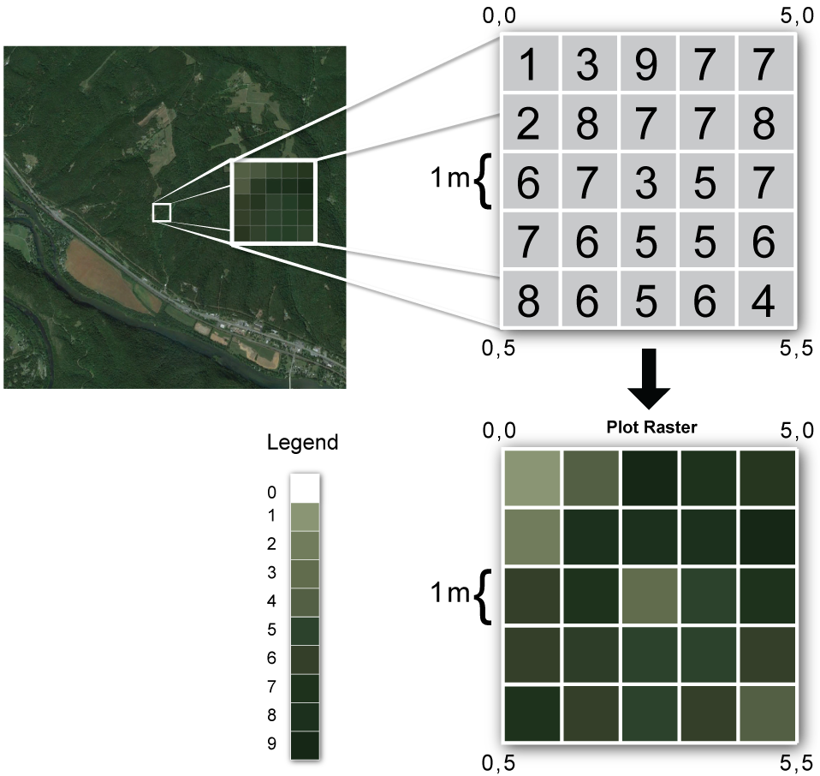
Overview

Slide 5
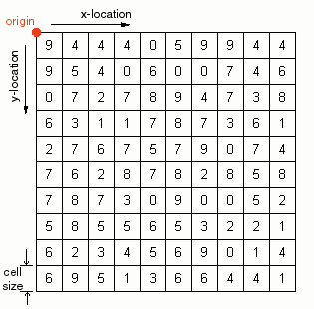
Raster Data Model
Origin is set explicitly
Cell size is always known
Cell references (row/column locations) are known
Cell values are referenced to row/column location
Values represent numerical phenomena or index codes for non-numerical phenomena

Slide 6
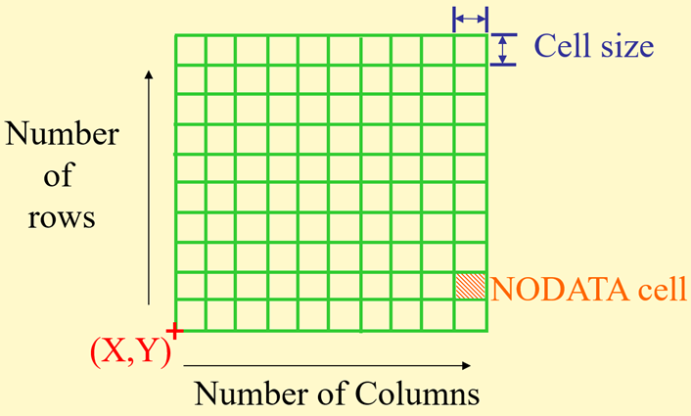
The grid data structure
Grid size is defined by extent, spacing and no data value information
Number of rows, number of column
Cell sizes (X and Y)
Top, left , bottom and right coordinates
Grid values
Real (floating decimal point)
Integer (may have associated attribute table)

Slide 7
Elements of Raster Data Model
A raster is also called a grid or an image in GIS
A raster represents a continuous surface, but for data storage and analysis, a raster is divided into rows, columns, and cells.
Cells are also called pixels with images.
The origin of rows and columns is typically at the upper-left corner of the raster.
Rows function as y-coordinates and columns as x-coordinates.
Each cell in the raster is explicitly defined by its row and column position.

Slide 8
Elements of Raster Data Model
Raster data represent points with single cells
Lines are represented with sequences of neighbouring cells
Polygons are represented with collections of contiguous (adjoining) cells

Slide 9
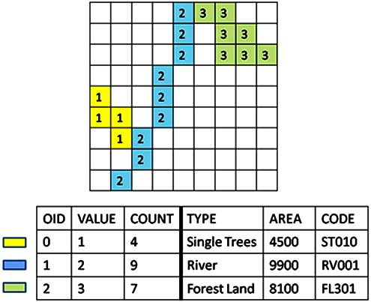
Elements of Raster Data Model
Cell value
Cell values in a raster can be categorical or numeric.
A land cover raster, for example, contains categorical data with 1 for urban land use, 2 for forested land, 3 for water body, and so on.
The land cover raster is also an example of an integer raster, as its cell values carry no decimal digits.
A precipitation raster, on the other hand, contains numeric data such as 20.15, 12.23, and so forth.
It is also an example of a floating-point raster, as its cell values include decimal digits.
Elevation raster contains numeric values portraying height above sea level

Slide 10
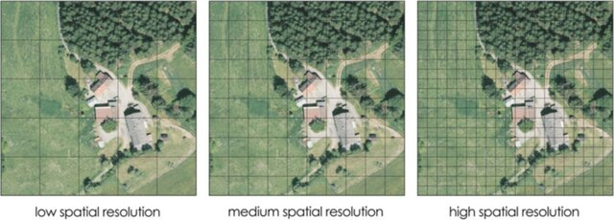
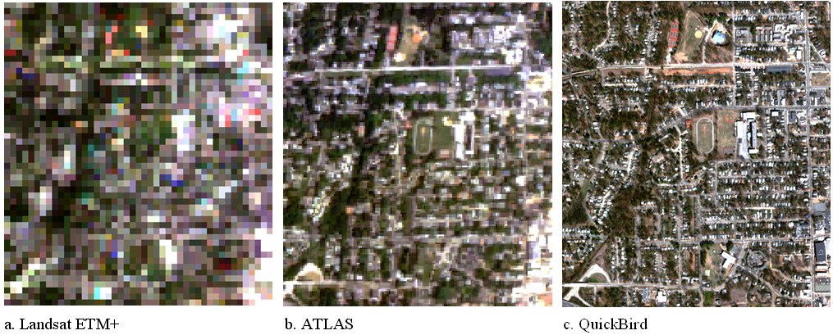
Elements of Raster Data Model
Cell size
Also known as spatial resolution
Refers to the size of the area represented by a single cell.
If a raster has a cell size of 100 square meters, it means each side of its cell is 10 meters in length. The raster is typically called a 10-meter raster.
The cell size determines the spatial resolution of a raster.
A 10-meter raster has a finer (higher) resolution than a 30-meter raster.
A large cell size cannot represent the precise location of spatial features, thus increasing the chance of having mixed features such as forest, pasture, and water in a cell.
These problems lessen when a raster uses a smaller cell size.
But a small cell size increases the data volume and the data processing time.

Slide 11
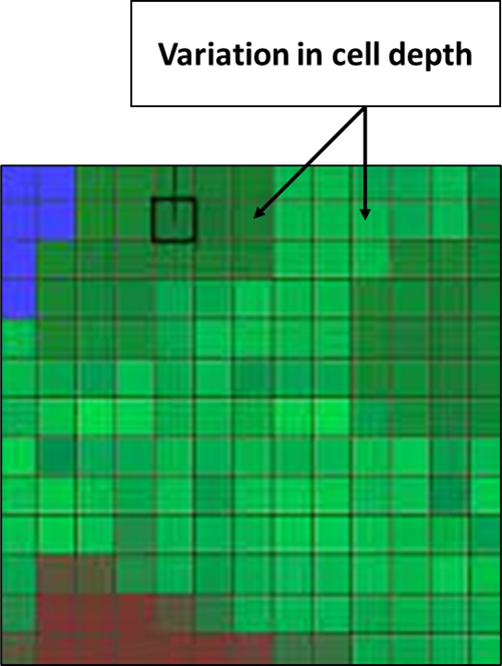
Elements of Raster Data Model
Cell depth
The cell depth of a raster refers to the number of bits for storing cell values.
A bit (short for binary digit), the smallest data unit in a computer, has a single binary value of either 0 or 1.
A byte is a sequence of bits, with 8 bits equaling 1 byte.
A higher cell depth means that the cell can store a wider range of values.
For example, an 8-bit raster can store 256 (28) possible values while a 16-bit (216) raster can store 65,536 possible values.
The way in which the cell values are stored can determine the data volume

Slide 12
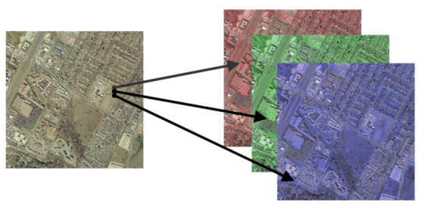
Elements of Raster Data Model
Raster Bands
A raster may have a single band or multiple bands.
Each cell in a single-band raster has only one cell value.
An example of a single-band raster is an elevation raster, with one elevation value at each cell location.
Each cell in a multiband raster is associated with more than one cell value (E.g., RGB).
An example of a multiband raster is a satellite image, which may have five, seven, or more bands at each cell location.

Slide 13
Elements of Raster Data Model
Spatial Reference
Raster data must have the spatial reference information so that they can align spatially with other data sets in a
GIS. For example, to superimpose an elevation raster on a vector-based soil layer, we must first make sure that both data sets are based on the same coordinate system.
A raster that has been processed to match a projected coordinate system is often called a georeferenced raster.
How does a raster match a projected coordinate system?
First, the columns of the raster correspond to the x-coordinates, and the rows correspond to the y-coordinates.

Slide 14
Elements of Raster Data Model
Spatial Reference
Because the origin of the raster is at the upper-left corner, as opposed to the lower-left corner for the projected coordinate system, the row numbers increase in the direction opposite that of the y-coordinates.
Second, the projected coordinates for each cell of the raster can be computed by using the x-, y-coordinates of the area extent of the raster.
Suppose an elevation raster has the following information on the number of rows, number of columns, cell size, and area extent expressed in UTM (Universal Transverse Mercator) coordinates:
Rows: 463, columns: 318, cell size: 30 meters
x-, y-coordinates at the lower-left corner: 499995, 5177175
x-, y-coordinates at the upper-right corner: 509535, 5191065

Slide 15
SATELLITE IMAGES
Remotely sensed satellite data are familiar to GIS users.
Satellite systems can be divided into passive and active
Passive systems, often referred to as optical systems, acquire spectral bands from the electromagnetic spectrum reflected or emitted from the Earth’s surface
Measured by wavelength (e.g., micrometer or μm), these spectral bands are recorded in the range of visible light (0.4 − 0.7 μm), near infrared (0.75 − 1.4 μm), and shortwave infrared (1.4 − 3.0 μm).
Optical satellite images can be panchromatic or multispectral.
Panchromatic images have a single band, which can be displayed in shades of gray, whereas multi-spectral images have multiple bands, which can be displayed in colour composites.

Slide 16
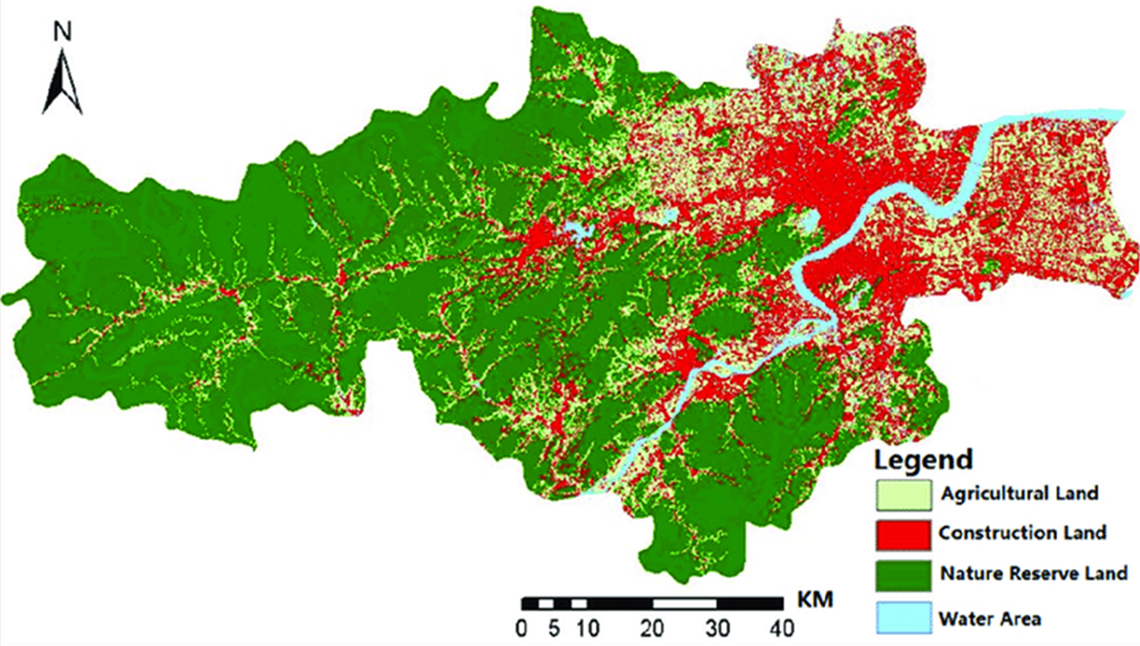
OTHER TYPES OF RASTER DATA
Land cover data
Land cover data are typically classified and com-piled from satellite imagery and are thus often presented as raster data.
The USGS, for example, oﬀers a series of three land cover databases: NLCD 2001, NLCD 2006, and NLCD 2011.
All three databases use a 16-class scheme classified from Landsat images with a spatial resolution of 30 meters (http://www.mrlc.gov/index.php).

Slide 17
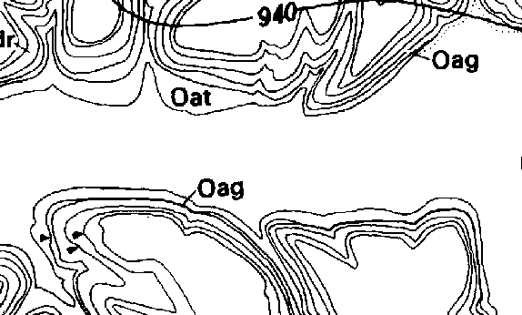
OTHER TYPES OF RASTER DATA
Bi-Level Scanned Files
A bi-level scanned file is a scanned image containing values of 1 or 0.
In GIS, bi-level scanned files are usually made for the purpose of digitizing.
They are scanned from paper or Mylar maps that contain boundaries of soils, parcels, and other features.
A GIS package usually has tools for converting bi-level scanned files into vector-based features.
Maps to be digitized are typically scanned at 300 or 400 dots per inch (dpi).

Slide 18
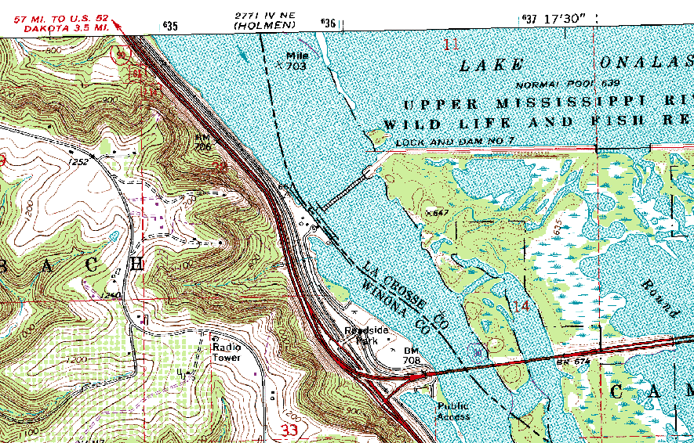
OTHER TYPES OF RASTER DATA
Digital Raster Graphics
A digital raster graphic (DRG) is a scanned image of a USGS topographic map.
The USGS scans the 7.5-minute topographic map at 250 to 500 dpi to produce the DRG with a ground resolution of 2.4 meters.
The USGS uses up to 13 colours on each 7.5-minute DRG.
Because these colours are based on an 8-bit (256) colour palette, they may not look exactly the same as on the pa-per maps.
USGS DRGs are geo-referenced to the UTM coordinate system, based on either NAD27 or NAD83.

Slide 19
RASTER DATA STRUCTURE
Contains information about the raster
Data Structure
Area Extent
Cell Size
Number of Bands
Value for “No Data”
Other types
Statistics file for each band
Color file associates colors with pixel values

Slide 20
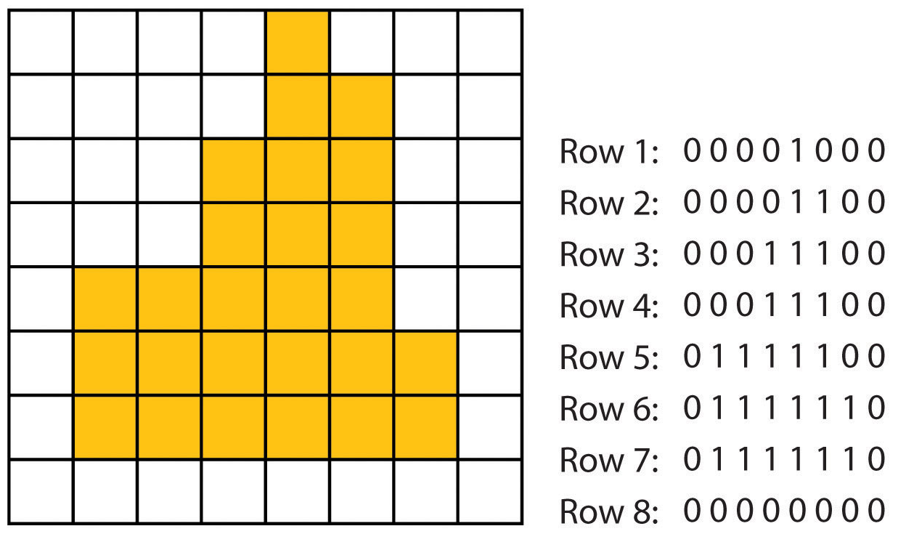
RASTER DATA STRUCTURE
Refers to the method or format for storing raster data so that it can be used efficiently
Raster data structure includes three types:
Cell-by-Cell Encoding
The cell-by-cell encoding method provides the simplest raster data structure.
A raster is stored as a matrix, and its cell values are written into a file by row and column
Functioning at the cell level, this method is an ideal choice if the cell values of a raster change continuously.
DEMs use the cell-by-cell data structure because the neighbouring elevation values are rarely the same

Slide 21
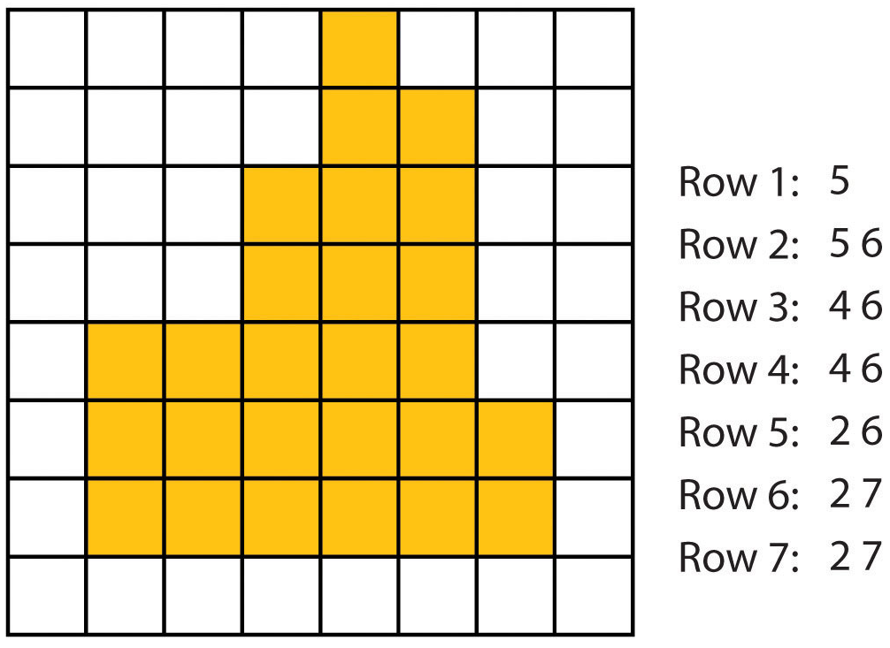
RASTER DATA STRUCTURE
Raster data structure includes three types:
Run-Length Encoding
Cell values are written into a file by row and group
Starting and ending cells with the same value
Method for encoding as well as compressing
Cell-by-cell encoding becomes inefficient if a raster contains many redundant cell values.
For example, a bi-level scanned file from a soil map has many 0s representing non-inked areas and only occasional 1s representing the inked soil lines.
Raster data with many repetitive cell values can be more efficiently stored using the run-length encoding (RLE) method, which records the cell values by row and by group.

Slide 22
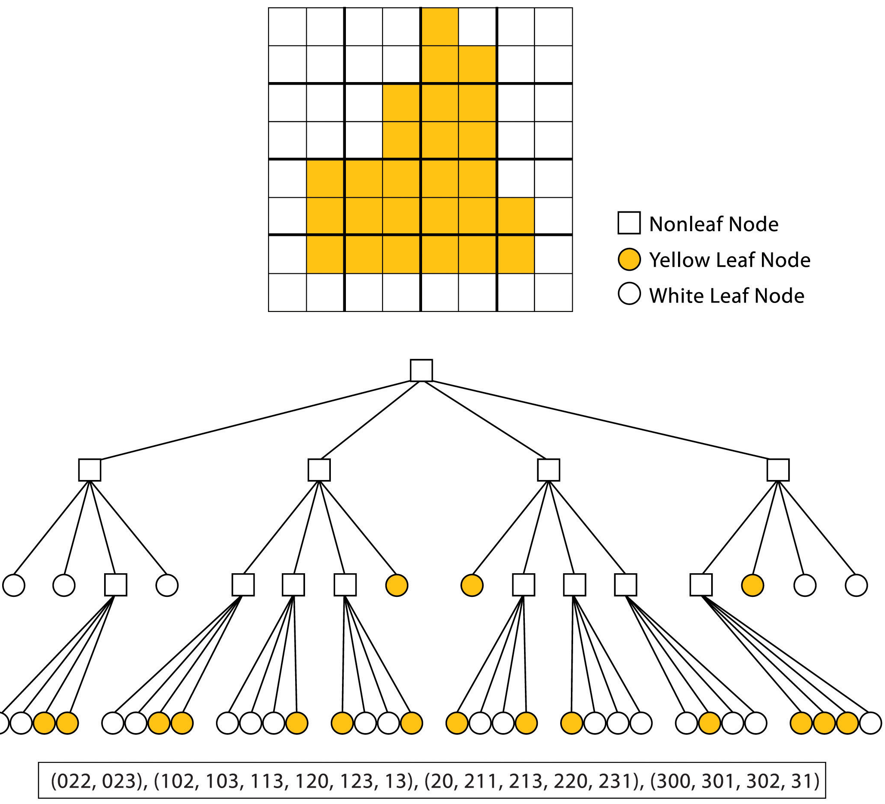
RASTER DATA STRUCTURE
Raster data structure includes three types:
Quad Tree Encoding
This method divides a raster into a hierarchy of quadrants that are subdivided based on similarly valued pixel
The division of the raster stops when a quadrant is made entirely from cells of the same value.
A quadrant that cannot be subdivided is called a “leaf node.”

Slide 23
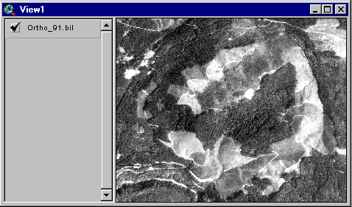
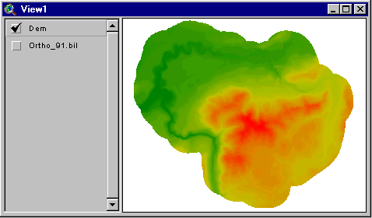
Representation of elevation with raster data
Digital orthophoto
Digital elevation model (DEM)

Slide 24
Raster Generalization
Largest share rule – assigns a value of a largest feature to a cell
Central point rule – assigns value of a feature situated at the centre of a cell
The largest share rule is almost always preferred
However, the central point rule is sometimes used in the interests of faster computing.
Largest share rule
Central point rule

Slide 25
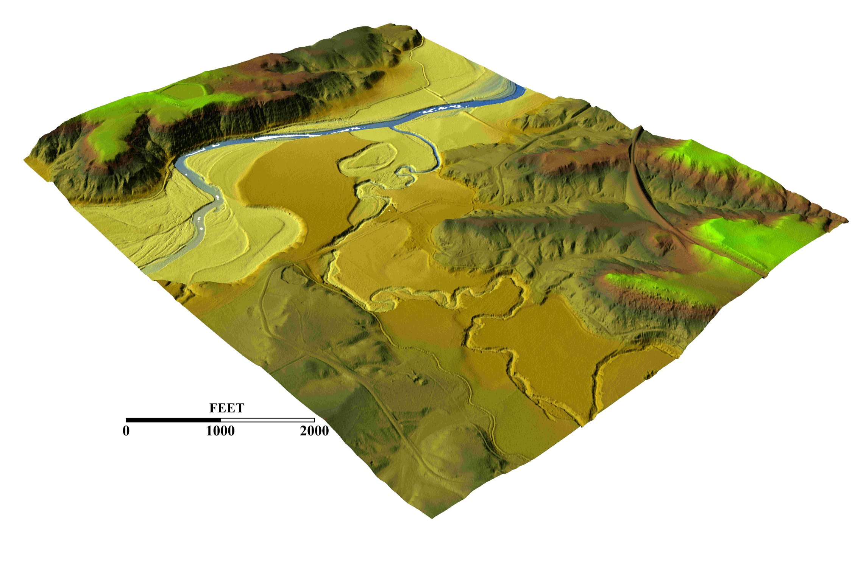
3-D representation with raster data model
3-D shows a third (z) dimension of data
Elevation is common z-dimension of a surface
Raster data has the capability to represent 3D feature

Slide 26
Advantages of raster data model
It is easy to produce,
Easy workflow and analysis
Has the distinct advantage of having fixed cell locations
Good for representing continuous features
Feature location cannot be tempered with
* Explore other advantages

Slide 27
Disadvantages of raster data model
Difficult to represent object smaller than cell size
Finer (higher) resolution produces data of large volume
Highly generalizes representation of discrete features
* Explore other disadvantages

Slide 28
The End

